Slide 1
Variance vs Bias
Some slides taken from Andrew Ng’s Machine Learning course https://www.coursera.org/learn/machine-learning

Slide 2
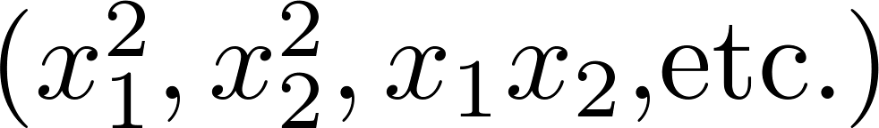
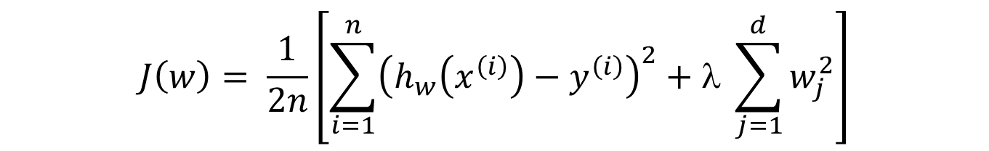
Debugging a learning algorithm:
Suppose you have implemented regularized linear regression to predict car prices.
However, when you test your hypothesis on a new set of cars, you find that it makes unacceptably large errors in its predictions. What should you try next?
$$J\left(w\right)= \frac{1}{2n}\left[\sum_{i=1}^{n}{{\left(h_{w}\left(x^{\left(i\right)}\right)−y^{\left(i\right)}\right)}^{2}}+λ \sum_{j=1}^{d}{w_{j}^{2}}\right]$$
Get more training examples
Try smaller sets of features
Try getting additional features
Try adding polynomial features
Try decreasing
Try increasing

Slide 3
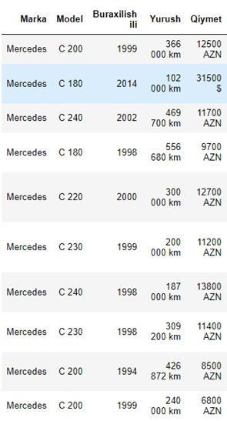
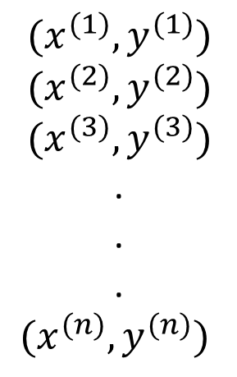
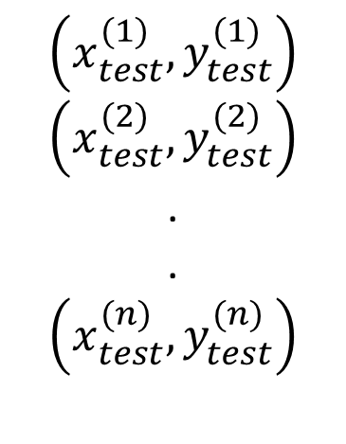
Evaluating your hypothesis
Dataset:
$${(x}^{(1)},y^{(1)})$$
$${(x}^{(2)},y^{(2)})$$
$${(x}^{(3)},y^{(3)})$$
.
.
.
$${(x}^{(n)},y^{(n)})$$
$$\left(x_{test}^{(1)},y_{test}^{(1)}\right)$$
$$\left(x_{test}^{(2)},y_{test}^{(2)}\right)$$
.
.
$$\left(x_{test}^{(n)},y_{test}^{(n)}\right)$$

Slide 4
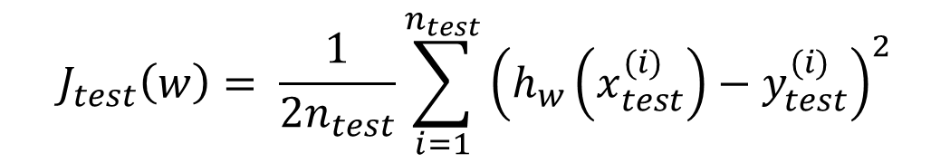
Training/testing procedure for linear regression
Learn parameter w from training data (minimizing training error J(w) )
Compute test set error:
$$J_{test}\left(w\right)= \frac{1}{2n_{test}}\sum_{i=1}^{n_{test}}{{\left(h_{w}\left(x_{test}^{(i)}\right)−y_{test}^{(i)}\right)}^{2}}$$

Slide 5
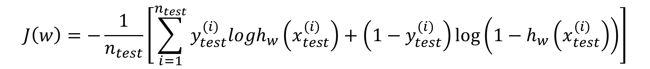
Training/testing procedure for logistic regression
Learn parameter w from training data
Compute test set error:
Misclassification error (0/1 misclassification error):
$$J\left(w\right)=−\frac{1}{n_{test}}\left[\sum_{i=1}^{n_{test}}{y_{test}^{(i)}logh_{w}\left(x_{test}^{(i)}\right)}+\left(1−y_{test}^{(i)}\right)\log\left(1−h_{w}\left(x_{test}^{(i)}\right)\right)\right]$$

Slide 6
Question:
Suppose an implementation of linear regression (without regularization) is badly overfitting the training set. In this case, we would expect
The training error to be low and the test error to be high
The training error to be low and the test error to be low
The training error to be high and the test error to be low
The training error to be high and the test error to be high

Slide 7
Question:
Suppose an implementation of linear regression (without regularization) is badly overfitting the training set. In this case, we would expect
The training error to be low and the test error to be high
The training error to be low and the test error to be low
The training error to be high and the test error to be low
The training error to be high and the test error to be high

Slide 8
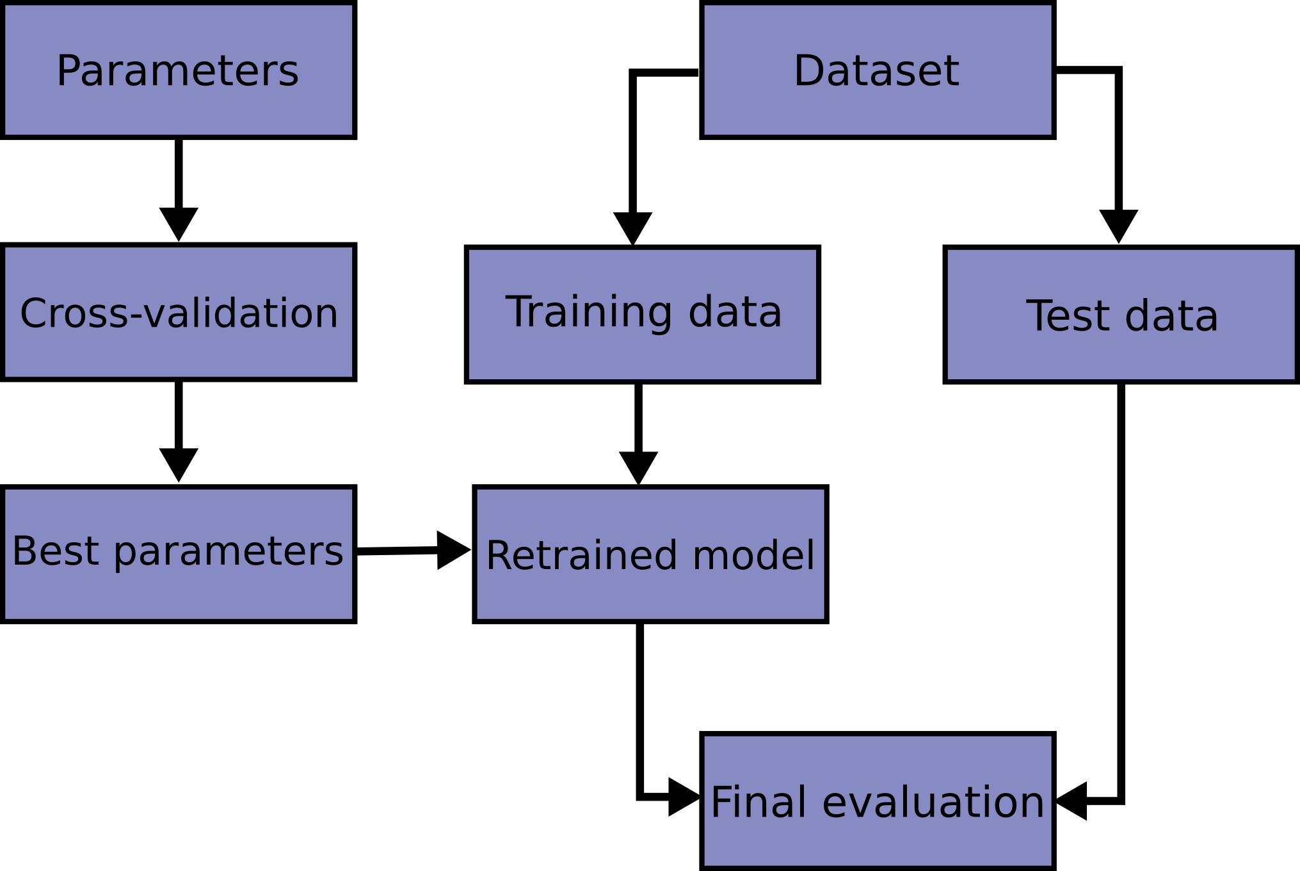
Evaluating estimator performance
https://scikit-learn.org/stable/modules/cross_validation.html

Slide 9
Model selection Training/validation/test sets
A training dataset is a dataset of examples used for learning which machine learning algorithm “learns,” relationships between the features and the target variable.
A validation dataset is a dataset of examples used to tune the hyperparameters (i.e. the architecture) of a classifier. It is sometimes also called the development set or the "dev set".
A dataset can be repeatedly split into a training dataset and a validation dataset: this is known as cross-validation. Cross-validation doesn't work in situations where you can't shuffle your data, most notably in time-series.
A test dataset is a dataset that is independent of the training dataset, but that follows the same probability distribution as the training dataset. Part of the original dataset can be set aside and used as a test set: this is known as the holdout method.
wikipedia.org

Slide 10

k-fold cross-validation (CV)
The training set is split into k smaller sets. The following procedure is followed for each of the k “folds”:
A model is trained using of the folds as training data;
the resulting model is validated on the remaining part of the data (i.e., it is used as a test set to compute a performance measure such as accuracy).
The performance measure reported by k-fold cross-validation is then the average of the values computed in the loop
>>> from sklearn import metrics
>>> from sklearn.model_selection import cross_val_score
>>> scores = cross_val_score( ... clf, X, y, cv=5, scoring='f1_macro')
>>> scores
https://scikit-learn.org/stable/modules/cross_validation.html

Slide 11

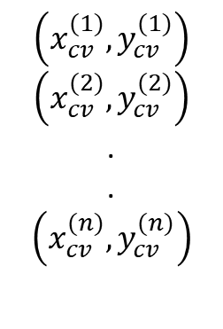
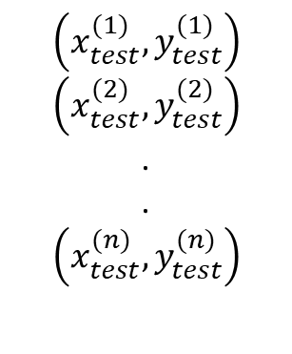
$${(x}^{(1)},y^{(1)})$$
$${(x}^{(2)},y^{(2)})$$
.
.
$${(x}^{(n)},y^{(n)})$$
Evaluating your hypothesis
Dataset:
$$\left(x_{cv}^{(1)},y_{cv}^{(1)}\right)$$
$$\left(x_{cv}^{(2)},y_{cv}^{(2)}\right)$$
.
.
$$\left(x_{cv}^{(n)},y_{cv}^{(n)}\right)$$
$$\left(x_{test}^{(1)},y_{test}^{(1)}\right)$$
$$\left(x_{test}^{(2)},y_{test}^{(2)}\right)$$
.
.
$$\left(x_{test}^{(n)},y_{test}^{(n)}\right)$$

Slide 12
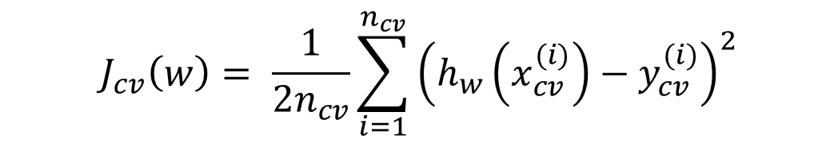
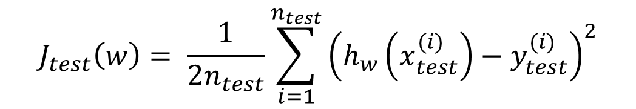
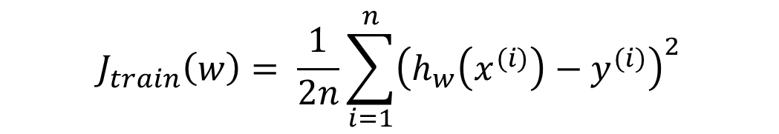
Train/validation/test error
Training error:
$$J_{train}\left(w\right)= \frac{1}{2n}\sum_{i=1}^{n}{{\left(h_{w}\left(x^{(i)}\right)−y^{(i)}\right)}^{2}}$$
Cross Validation error:
$$J_{cv}\left(w\right)= \frac{1}{2n_{cv}}\sum_{i=1}^{n_{cv}}{{\left(h_{w}\left(x_{cv}^{(i)}\right)−y_{cv}^{(i)}\right)}^{2}}$$
Test error:
$$J_{test}\left(w\right)= \frac{1}{2n_{test}}\sum_{i=1}^{n_{test}}{{\left(h_{w}\left(x_{test}^{(i)}\right)−y_{test}^{(i)}\right)}^{2}}$$

Slide 13
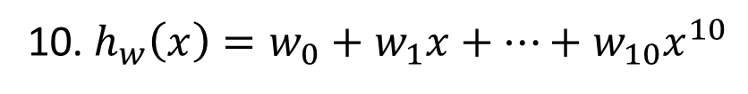
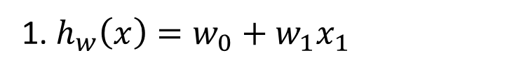
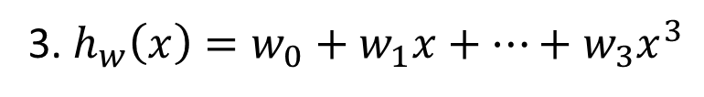
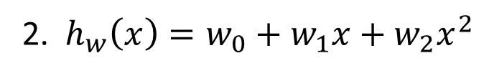
Model selection. Which model?
1. $h_{w}\left(x\right)=w_{0}+w_{1}x_{1}$
2. $h_{w}\left(x\right)=w_{0}+w_{1}x+w_{2}x^{2}$
3. $h_{w}\left(x\right)=w_{0}+w_{1}x+…+w_{3}x^{3}$
10. $h_{w}\left(x\right)=w_{0}+w_{1}x+…+w_{10}x^{10}$
Compare $J_{cv}\left(w\right)$of different hypothesis and choose lowest one

Slide 14
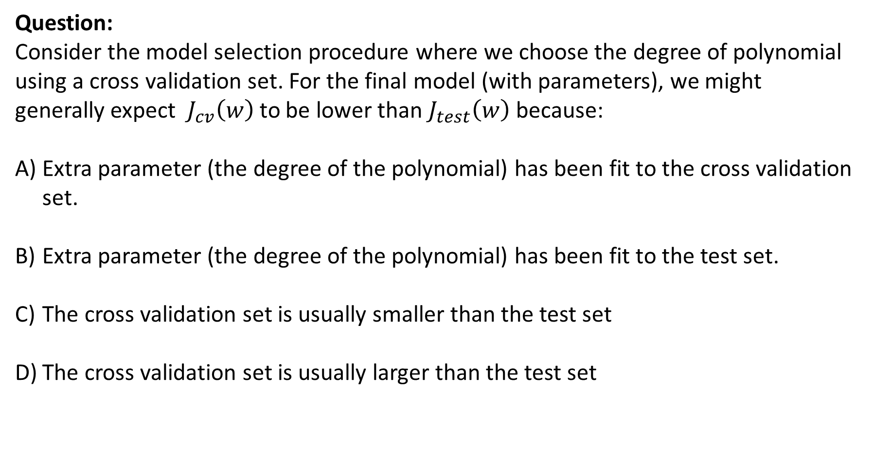
Question:
Consider the model selection procedure where we choose the degree of polynomial using a cross validation set. For the final model (with parameters), we might generally expect $J_{cv}\left(w\right)$to be lower than $J_{test}\left(w\right)$ because:
Extra parameter (the degree of the polynomial) has been fit to the cross validation set.
Extra parameter (the degree of the polynomial) has been fit to the test set.
The cross validation set is usually smaller than the test set
The cross validation set is usually larger than the test set

Slide 15
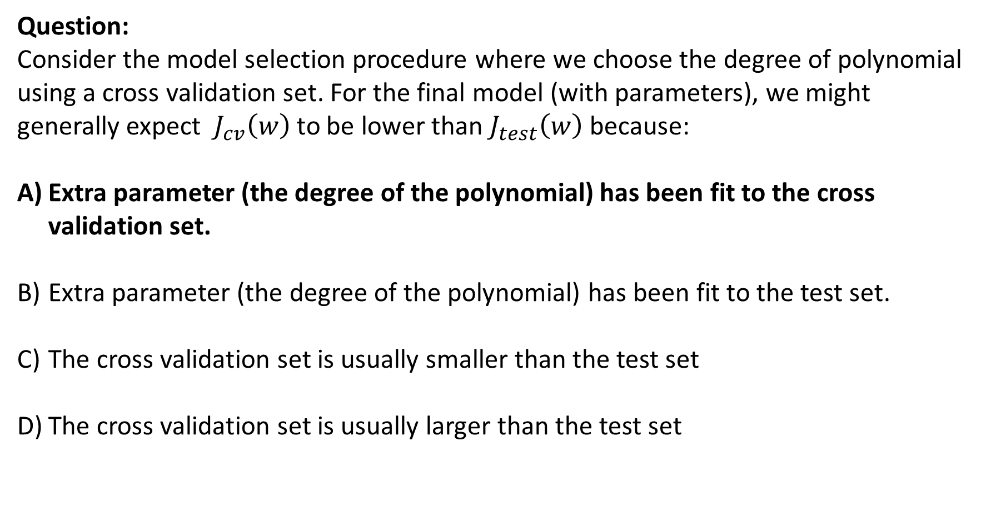
Question:
Consider the model selection procedure where we choose the degree of polynomial using a cross validation set. For the final model (with parameters), we might generally expect $J_{cv}\left(w\right)$to be lower than $J_{test}\left(w\right)$ because:
Extra parameter (the degree of the polynomial) has been fit to the cross validation set.
Extra parameter (the degree of the polynomial) has been fit to the test set.
The cross validation set is usually smaller than the test set
The cross validation set is usually larger than the test set

Slide 16
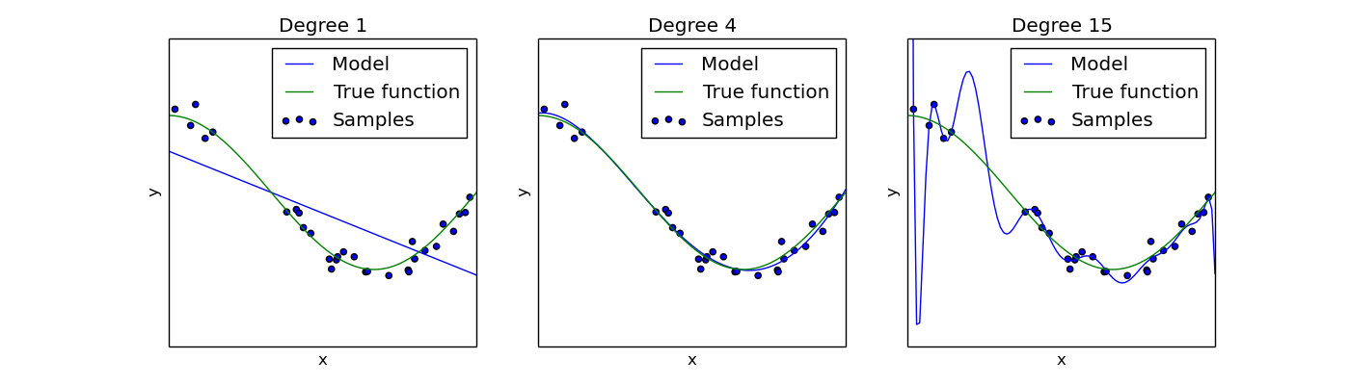

Bias/Variance
$$h_{w}\left(x\right)=w_{0}+w_{1}x$$
$$h_{w}\left(x\right)=w_{0}+w_{1}x+{w_{2}x}^{2}+{w_{3}x}^{3}+{w_{4}x}^{4}$$
$$h_{w}\left(x\right)=w_{0}+w_{1}x+{w_{2}x}^{2}+…+{w_{15}x}^{15}$$
High bias
(underfit)
“Just right”
High variance
(overfit)
Python source code : https://scikit-learn.org/0.15/auto_examples/plot_underfitting_overfitting.html

Slide 17

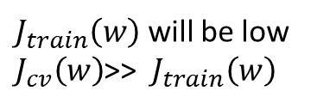
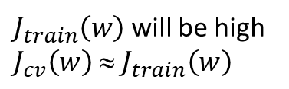

Diagnosing bias vs. variance (Detection from curves)
Suppose your learning algorithm is performing less well than you were hoping. ($J_{cv}\left(w\right)$ or $J_{test}\left(w\right)$ is high.) Is it a bias problem or a variance problem?
Bias (underfit):
$$J_{cv}\left(w\right)$$
“just right”
(cross validation
error)
error
$J_{train}\left(w\right)$ will be high
$$J_{cv}\left(w\right) ≈ J_{train}\left(w\right)$$
Variance
Variance (overfit):
Bias
$$J_{train}\left(w\right)$$
(training error)
$J_{train}\left(w\right)$ will be low
$J_{cv}\left(w\right)$>>$J_{train}\left(w\right)$
p=1
p=4
p=15
degree of polynomial p

Slide 18
Question:
Suppose you have a classification problem. Suppose your training error is 0.10, and your cross validation error is 0.30. What problem is the algorithm most likely to be suffering from?
High bias (overfitting)
High Bias (underfitting)
High variance (overfitting)
High variance (underfitting)

Slide 19
Question:
Suppose you have a classification problem. Suppose your training error is 0.10, and your cross validation error is 0.30. What problem is the algorithm most likely to be suffering from?
High bias (overfitting)
High Bias (underfitting)
High variance (overfitting)
High variance (underfitting)

Slide 20
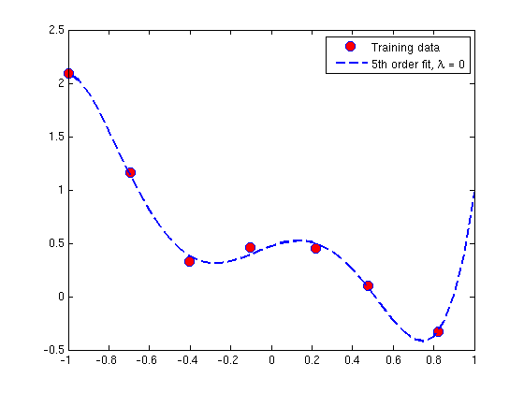
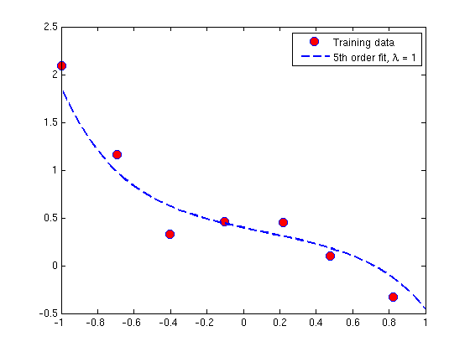
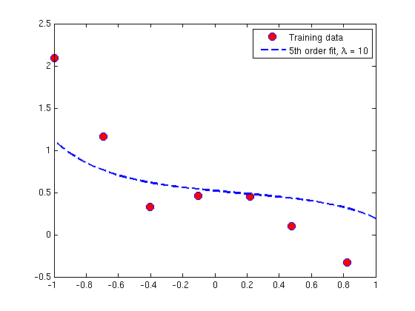
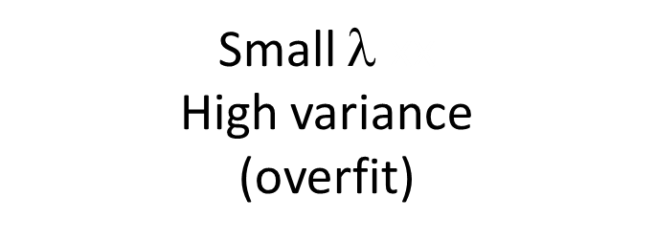

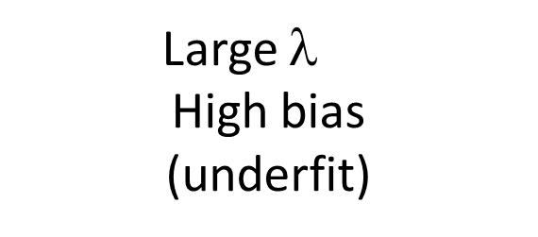
Linear regression with regularization bias/variance
Small $$xx
High variance
(overfit)
Intermediate $$xx
“Just right”
Large $$xx
High bias
(underfit)
http://openclassroom.stanford.edu/MainFolder/DocumentPage.php?course=MachineLearning&doc=exercises/ex5/ex5.html

Slide 21
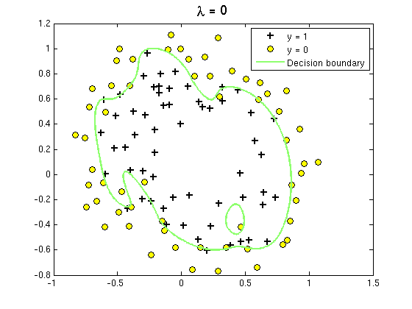
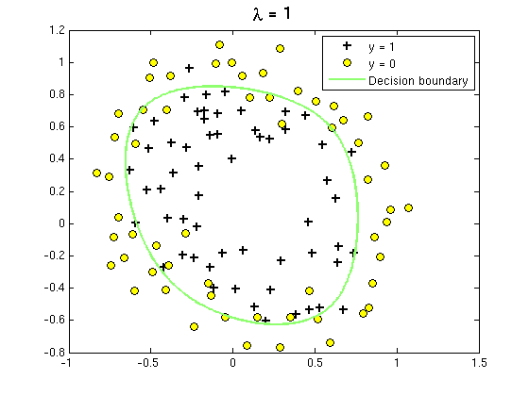
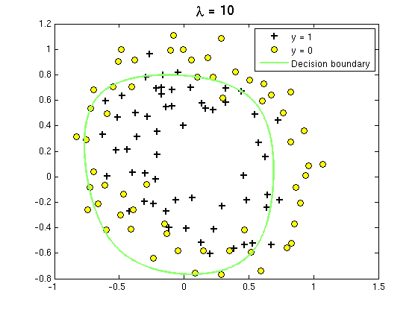
Regularization for Classification problem
bias/variance
Small $$xx
High variance
(overfit)
Intermediate $$xx
“Just right”
Large $$xx
High bias
(underfit)
http://openclassroom.stanford.edu/MainFolder/DocumentPage.php?course=MachineLearning&doc=exercises/ex5/ex5.html

Slide 22





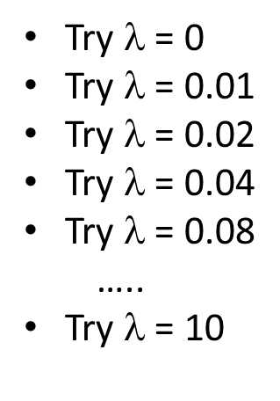


Choosing the regularization parameter $$
Bias/variance as a function of the regularization parameter $$
$$J\left(w\right)$$
Variance
Bias
Try $$ = 0
Try $$ = 0.01
Try $$ = 0.02
Try $$ = 0.04
Try $$ = 0.08
…..
Try $$ = 10
“just right”
$$J_{cv}\left(w\right)$$
$J_{train}\left(w\right)$
Calculate $J_{train}\left(w\right)$ and $J_{cv}\left(w\right)$ for different $$

Slide 23



Learning curves
$$h_{w}\left(x\right)=w_{0}+w_{1}x+{w_{2}x}^{2}$$
error
$$J_{cv}\left(w\right)$$
$$J_{train}\left(w\right)$$
n (training set size)

Slide 24



$$h_{w}\left(x\right)=w_{0}+w_{1}x$$
High bias
price
error
$$J_{cv}\left(w\right)$$
high error
$$J_{train}\left(w\right)$$
year
n (training set size)
price
If a learning algorithm is suffering from high bias, getting more training data will not (by itself) help much.
_{year}

Slide 25


$$h_{w}\left(x\right)=w_{0}+w_{1}x+{w_{2}x}^{2}+…+{w_{15}x}^{15}$$
High variance
(and small )
error
price
$$J_{cv}\left(w\right)$$
gap
$$J_{train}\left(w\right)$$
year
n (training set size)
price
If a learning algorithm is suffering from high variance, getting more training data is likely to help.
_{year}

Slide 26
Question:
In which of the following circumstances is getting more training data likely to significantly help a learning algorithm’s performance?
Algorithm is suffering from high bias
Algorithm is suffering from high variance
Cross validation error is much larger than training error
Cross validation error is about the same as training error

Slide 27
Question:
In which of the following circumstances is getting more training data likely to significantly help a learning algorithm’s performance?
Algorithm is suffering from high bias
Algorithm is suffering from high variance
Cross validation error is much larger than training error
Cross validation error is about the same as training error

Slide 28
Deciding what to try next
Debugging a learning algorithm:
Suppose you have implemented regularized linear regression to predict car prices. However, when you test your hypothesis on a new set of cars, you find that it makes unacceptably large errors in its predictions. What should you try next?
Get more training examples
Try smaller sets of features
Try getting additional features
Try adding polynomial features
Try decreasing
Try increasing
-fixes high variance
-fixes high variance
-fixes high bias
-fixes high bias
-fixes high bias
-fixes high variance

Slide 29
□ A model with more parameters is more prone to overfitting and typically has higher variance.
□ When debugging learning algorithms, it is useful to plot a learning curve to understand if there is a high bias or high variance problem.
□ If a learning algorithm is suffering from high variance, adding more training examples is likely to improve the test error.
□ We always prefer models with high variance (over those with high bias) as they will able to better fit the training set.

Slide 30


Slide 31
Reading material:
Part VI. Regularization and model selection. Andrew Ng.
http://cs229.stanford.edu/notes2019fall/cs229-notes5.pdf

